Slide 1
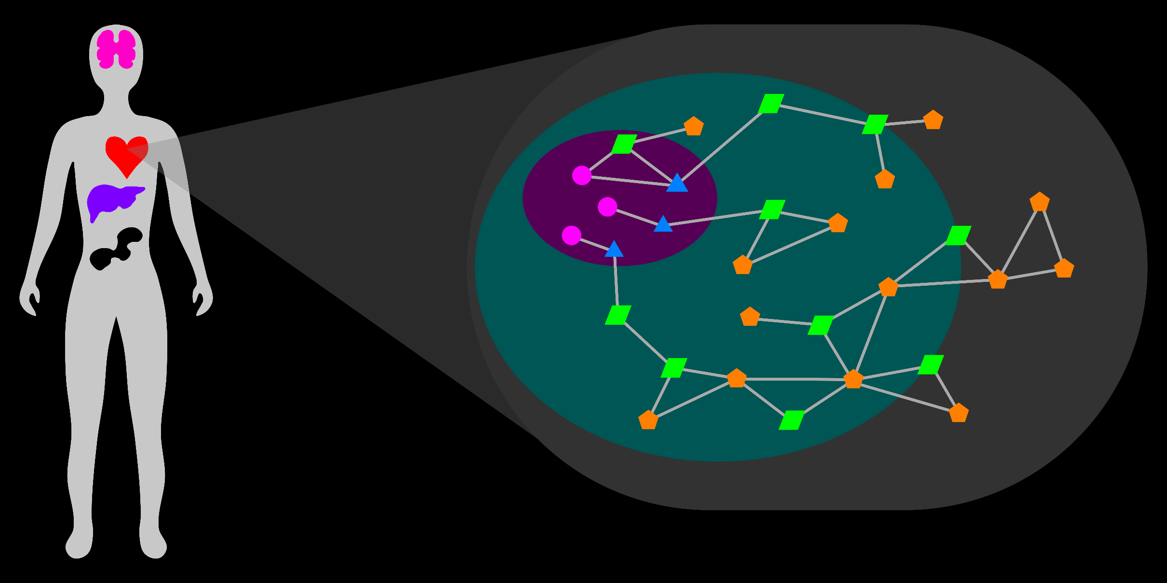
Visual Exploration and Analysis of the Metabolic Network
Rutter Team Retreat
14 October 2016
T Cameron Waller
Notes:
Metabolism is an integral part of the biological system (life).
Defects in metabolism drive many human diseases (if you do not believe me, listen to the other talks).
To understand life, health, and disease, it is necessary to study metabolism from a holistic perspective, within its true context.

Slide 2

Holistic Study Of Metabolism
Biology
Pharmacology
Notes:
An holistic study of metabolism considers the entire metabolic network and its context within the biological system.
Why is an holistic study important?
Biology
Pharmacology

Slide 3
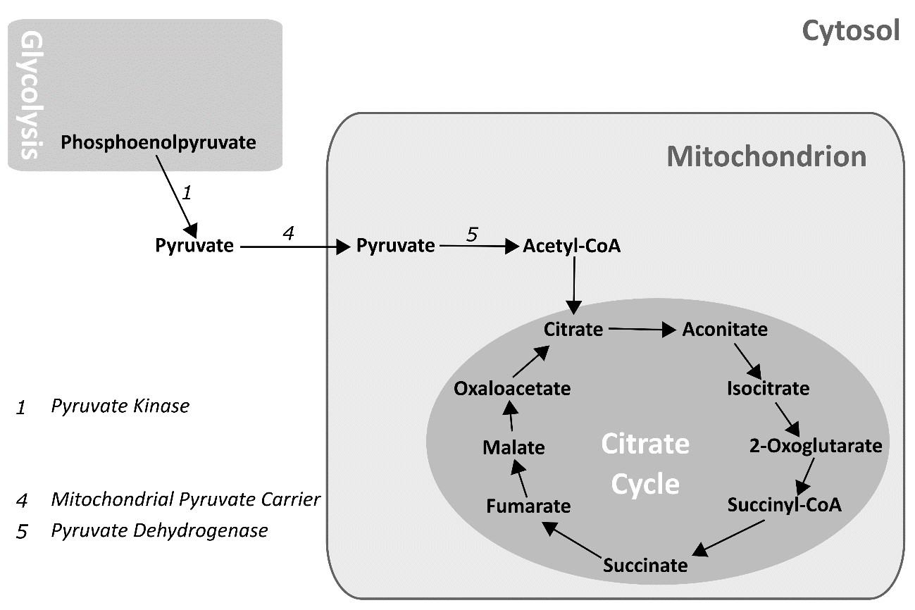
Holistic Study Of Metabolism
Biology
Pharmacology
1. New functions and processes
Bricker et al, Science, 2012
Notes:
Biology
1) New functions and processes
-Confident discoveries require comprehensive current knowledge (mitochondrial pyruvate).
-Compensatory functions can interfere (need to acknowledge).
-Recognize missing parts of the system (transcriptional regulation).
2) Perturbations in disease
Pharmacology

Slide 4
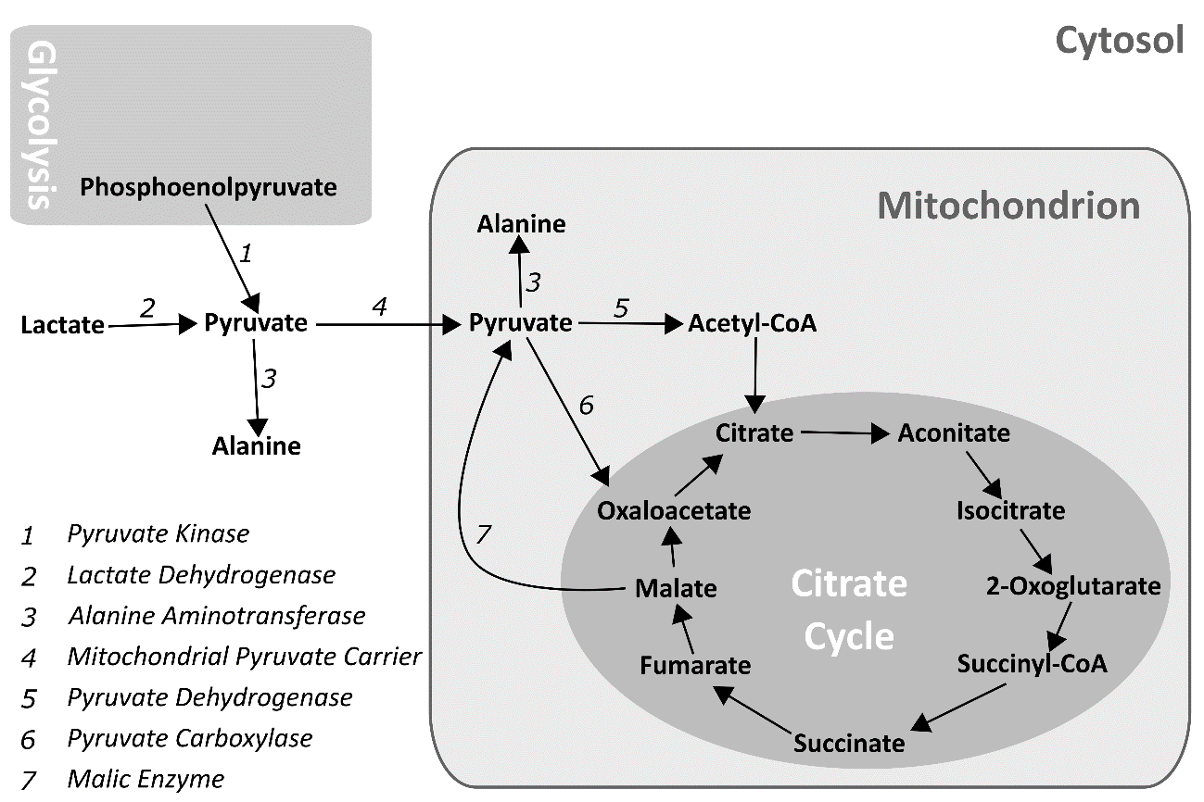
Holistic Study Of Metabolism
Biology
Pharmacology
1. New functions and processes
Notes:
Biology
1) New functions and processes
-Confident discoveries require comprehensive current knowledge (mitochondrial pyruvate).
-Compensatory functions can interfere (need to acknowledge).
-Recognize missing parts of the system (transcriptional regulation).
2) Perturbations in disease
Pharmacology

Slide 5
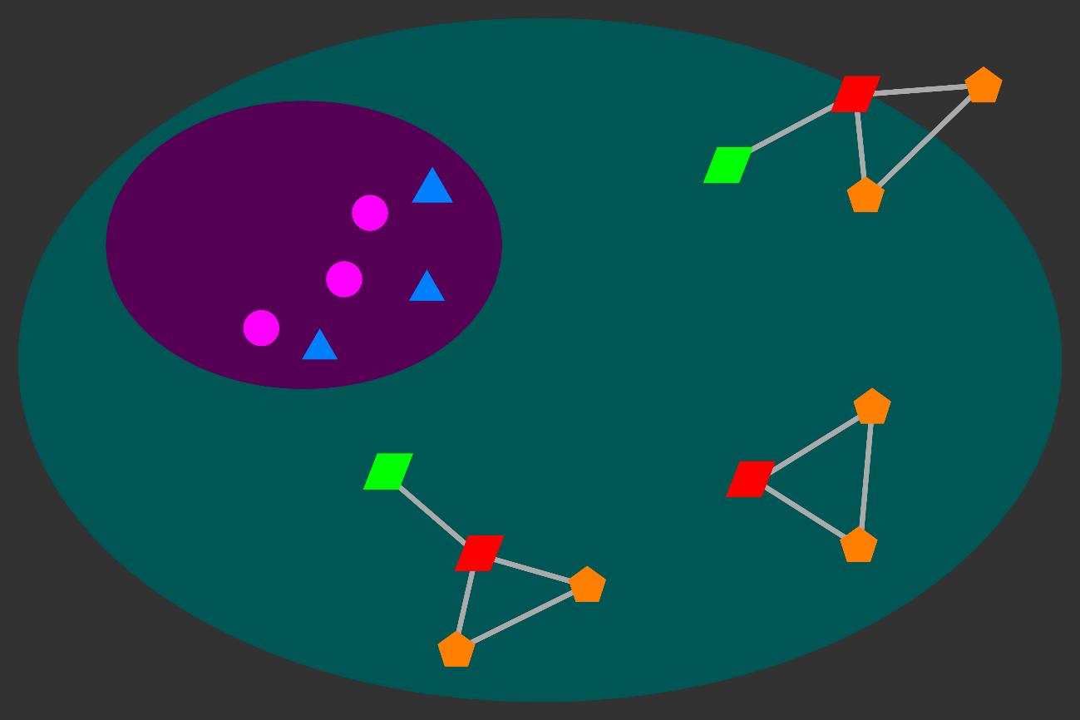
Holistic Study Of Metabolism
Biology
Pharmacology
1. New functions and processes
Notes:
Biology
1) New functions and processes
-Confident discoveries require comprehensive current knowledge (mitochondrial pyruvate).
-Compensatory functions can interfere (need to acknowledge).
-Recognize missing parts of the system (transcriptional regulation).
2) Perturbations in disease
-Understand the healthy regulation and interaction between processes to recognize perturbations in disease.
Pharmacology

Slide 6
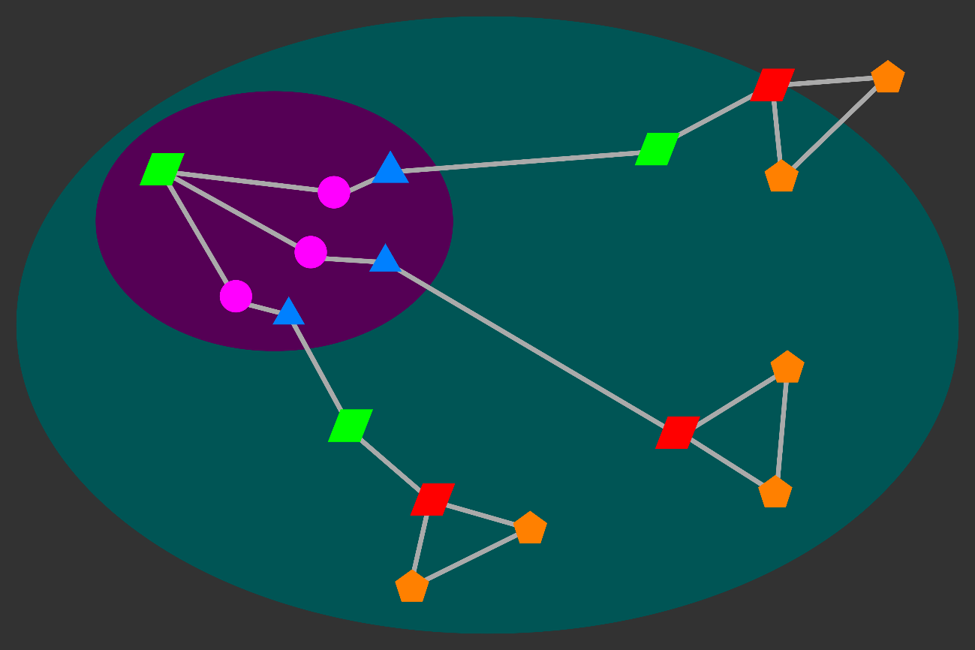
Holistic Study Of Metabolism
Biology
Pharmacology
1. New functions and processes
Notes:
Biology
1) New functions and processes
-Confident discoveries require comprehensive current knowledge (mitochondrial pyruvate).
-Compensatory functions can interfere (need to acknowledge).
-Recognize missing parts of the system (transcriptional regulation).
2) Perturbations in disease
Pharmacology

Slide 7
Holistic Study Of Metabolism
Biology
Pharmacology
1. New functions and processes
2. Perturbations in disease
Notes:
Biology
1) New functions and processes
2) Perturbations in disease
-Understand the healthy regulation and interaction between processes to recognize perturbations in disease.
Pharmacology

Slide 8
Holistic Study Of Metabolism
Biology
Pharmacology
1. New functions and processes
2. Perturbations in disease
Notes:
Biology
Pharmacology
1) Drug targets
-Ensure specificity to relevant process(es) (avoid side-effects).
-Evaluate target’s potential to influence relevant process(es) (rate-limiting steps, junctions between processes).
2) Broad effects
-Evaluate broad influence of drug on the system.
3) New treatments
-Exploit side-effects of old drugs for new treatments.

Slide 9
Holistic Study Of Metabolism
Biology
Pharmacology
1. New functions and processes
1. Drug targets
2. Perturbations in disease
Notes:
Biology
Pharmacology
1) Drug targets
-Ensure specificity to relevant process(es) (avoid side-effects).
-Evaluate target’s potential to influence relevant process(es) (rate-limiting steps, junctions between processes).
2) Broad effects
3) New treatments

Slide 10
Holistic Study Of Metabolism
Biology
Pharmacology
1. New functions and processes
1. Drug targets
2. Perturbations in disease
2. Broad effects
Notes:
Biology
Pharmacology
1) Drug targets
2) Broad effects
-Evaluate broad influence of drug on the system.
3) New treatments

Slide 11
Holistic Study Of Metabolism
Biology
Pharmacology
1. New functions and processes
1. Drug targets
2. Perturbations in disease
2. Broad effects
3. New treatments
Notes:
Biology
Pharmacology
1) Drug targets
2) Broad effects
3) New treatments
-Exploit side-effects of old drugs for new treatments.

Slide 12
Holistic Study Of Metabolism
Biology
Pharmacology
1. New functions and processes
1. Drug targets
2. Perturbations in disease
2. Broad effects
3. New treatments
Notes:
An holistic study of metabolism considers the entire metabolic network and its context within the biological system.
Why is an holistic study important?
Biology
1) New functions and processes
-Confident discoveries require comprehensive current knowledge (mitochondrial pyruvate).
-Compensatory functions can interfere (need to acknowledge).
-Recognize missing parts of the system (transcriptional regulation).
2) Perturbations in disease
-Understand the healthy regulation and interaction between processes to recognize perturbations in disease.
Pharmacology
1) Drug targets
-Ensure specificity to relevant process(es) (avoid side-effects).
-Evaluate target’s potential to influence relevant process(es) (rate-limiting steps, junctions between processes).
2) Broad effects
-Evaluate broad influence of drug on the system.
3) New treatments
-Exploit side-effects of old drugs for new treatments.

Slide 13
Holistic Study Of Metabolism… Data
Genomics
Transcriptomics
Genetic Interaction
Functional Characterization
Proteomics
Chromatin Immunoprecipitation
Metabolomics
Location
Notes:
There are many sources of information with broad coverage of the biological system.
Functional characterization
Tissue and subcellular localization
Many databases

Slide 14
Metabolic Network: Entities (Nodes)
Entities:
Genes
Transcripts
Proteins
Metabolites
~ 70,000
> 70,000
~ 30,000
~ 30,000
Properties:
Location/Compartment
Cofactor
Attributes:
Abundance
Modification
Notes:
Entities: Genes, Transcripts, Proteins, Metabolites
Represent entity by node or graph vertex

Slide 15
Metabolic Network: Relations (Links)
Entities:
Genes
Transcripts
Proteins
Metabolites
~ 70,000
> 70,000
~ 30,000
~ 30,000
Relations:
Eode:
Properties:
Metabolic Pathway
Expression:
Anabolism/Catabolism
Reduction/Oxidation
Regulation:
Reaction Rate
Transport:
Directionality
Catalysis:
Reaction:
Notes:
Relations:
-Encoding: Biological Sequences, Genetic Code (Gene-Transcript-Protein)
-Expression: Regulation of transcription and translation (Protein-Gene, Protein-Transcript)
-Regulation: Allosteric regulation (Metabolite-Protein), Post-translational modification of proteins (Protein-Protein)
-Transport: Metabolite transport (Protein-Metabolite)
-Catalysis: Enzymatic catalysis (Protein-Metabolite)
-Reaction: Chemical reactions (Metabolite-Metabolite)
Represent relation by link or graph edge.

Slide 16
Metabolic Network: Relations (Links)
Entities:
Genes
Transcripts
Proteins
Metabolites
~ 70,000
> 70,000
~ 30,000
~ 30,000
Relations:
Encoding:
Properties:
Metabolic Pathway
Expression:
Anabolism/Catabolism
Reduction/Oxidation
Regulation:
Reaction Rate
Transport:
Directionality
Catalysis:
Reaction:
Notes:
Need to consider (and associate data to) entire network.
Too many types and counts of entities and relations to represent simultaneously.
Essential to represent subset according to interest.

Slide 17
Holistic Study Of Metabolism… Data Visualization
Computer
Human
1. Data organization
1. Trend Recognition
2. Iteration
2. Interpretation
3. Intuition
Notes:
Visualization mediates interaction between computers and humans.
Computers organize data well (search exactly, no forget).
Computers perform iterative processes exactly.
Humans recognize trends well.
Humans interpret information in the appropriate context.
Humans have intuition and design experiments well.

Slide 18
Network Visualization: Problems and Solutions

Slide 19
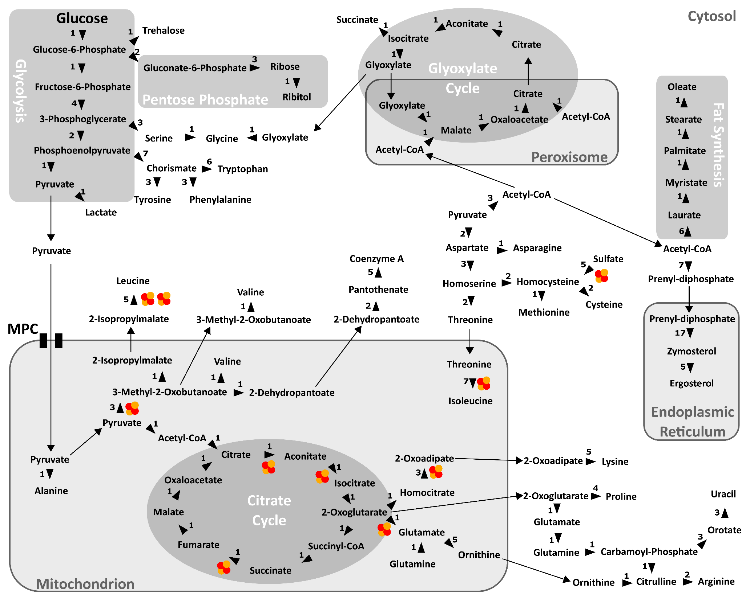
Notes:
Incomplete representation of metabolism
Arbitrary bias
Neglect of potentially-relevant nodes and links
Poor mapping of data
Map-like layout distorts network connectivity/topology

Slide 20
Network Visualization: Problems and Solutions
Arbitrary Bias
Bias in selection of subset of interest.
Complete System
Select from comprehensive system.

Slide 21
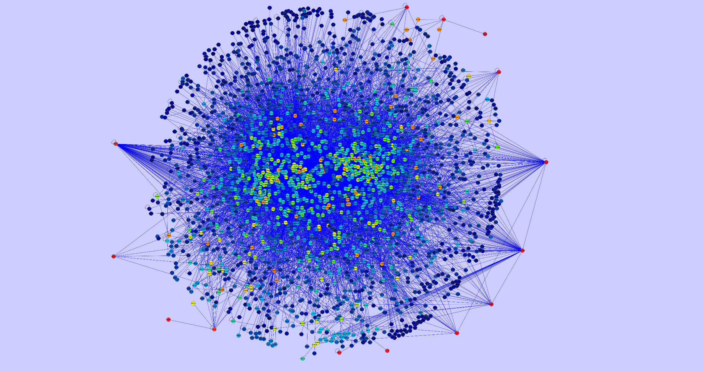
Gabor Ivan, Vince Grolmusz. Bioinformatics. 2010.

Slide 22
Network Visualization: Problems and Solutions
Arbitrary Bias
Bias in selection of subset of interest.
Complete System
Select from comprehensive system.
Scalability
Too many aspects to represent simultaneously.
Query-Based Exploration
Represent relevant subsets.
Interactive exploration.

Slide 23
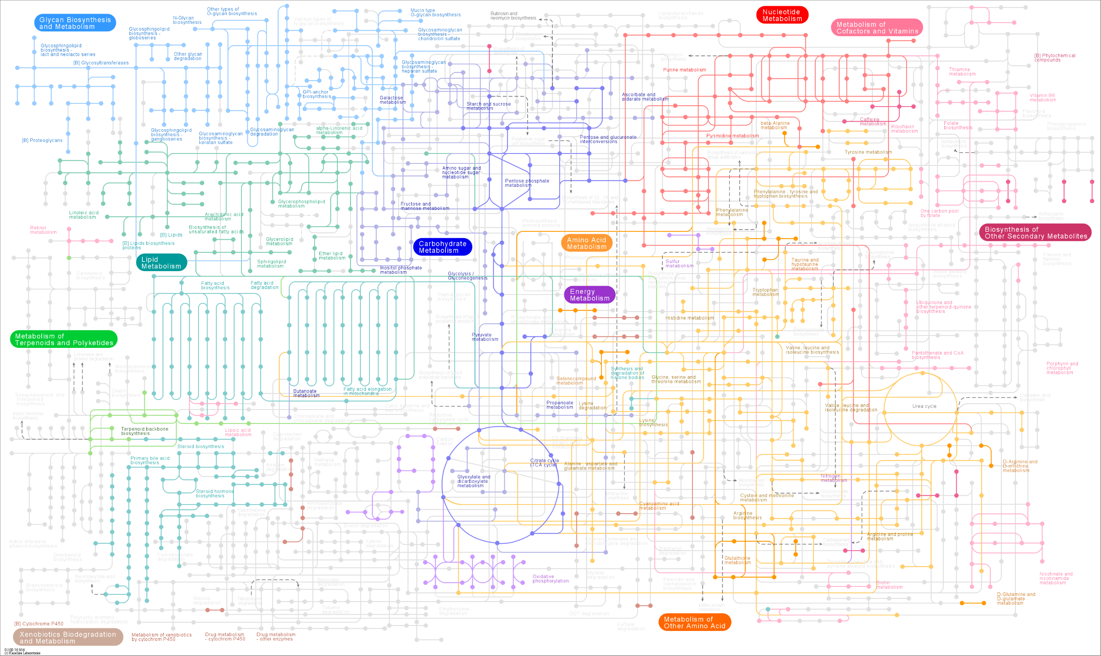

http://www.genome.jp/kegg/atlas.html

Slide 24
Network Visualization: Problems and Solutions
Arbitrary Bias
Bias in selection of subset of interest.
Complete System
Select from comprehensive system.
Scalability
Too many aspects to represent simultaneously.
Query-Based Exploration
Represent relevant subsets.
Interactive exploration.
Layout
Layout represents some aspects while distorting others.
Dynamic Layout
Represent network according to interest.

Slide 25
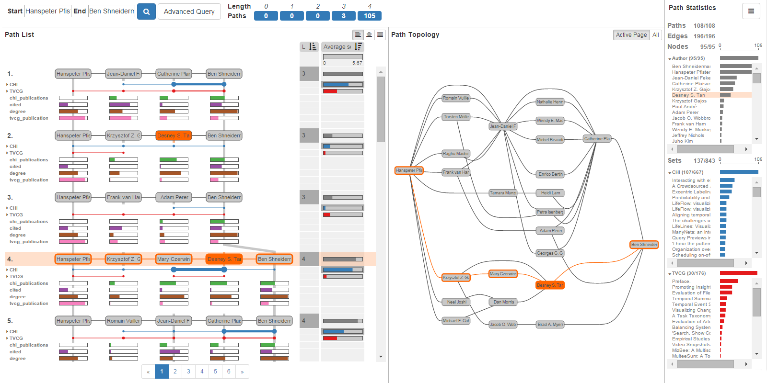
Network Visualization: Query-Based Exploration And Analysis
PathFinder
Christian Partl, … Alexander Lex. EuroVis. 2016.

Slide 26
Strategy
Data Visualization
(Human Computer Interaction)
Usability
(Design, Evaluation)
Tools
(Software Development)
1. Interviews
2. Comparison
1. Python
3. Trials
2. JavaScript
3. D3
Notes:
How are we solving these problems?
I am learning principles and techniques of data visualization.
I am learning tools for software development.
Python is a general programming language that is very capable, versatile, and popular in the scientific community.
JavaScript is the most popular programming language of the internet, and it is especially effective for interactive interfaces.
D3 is a JavaScript package, or set of tools, that is excellent for data visualization.

Slide 27
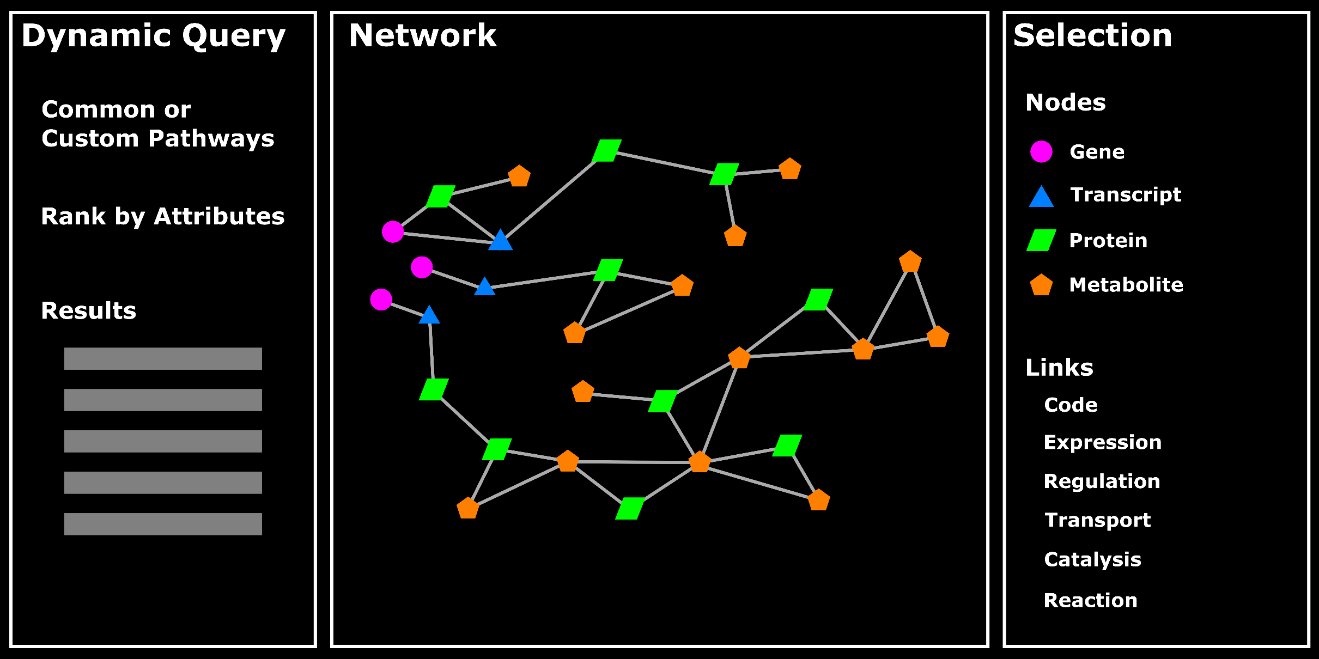
Network Visualization: Query-Based Exploration And Analysis
Interface Design Concept

Slide 28
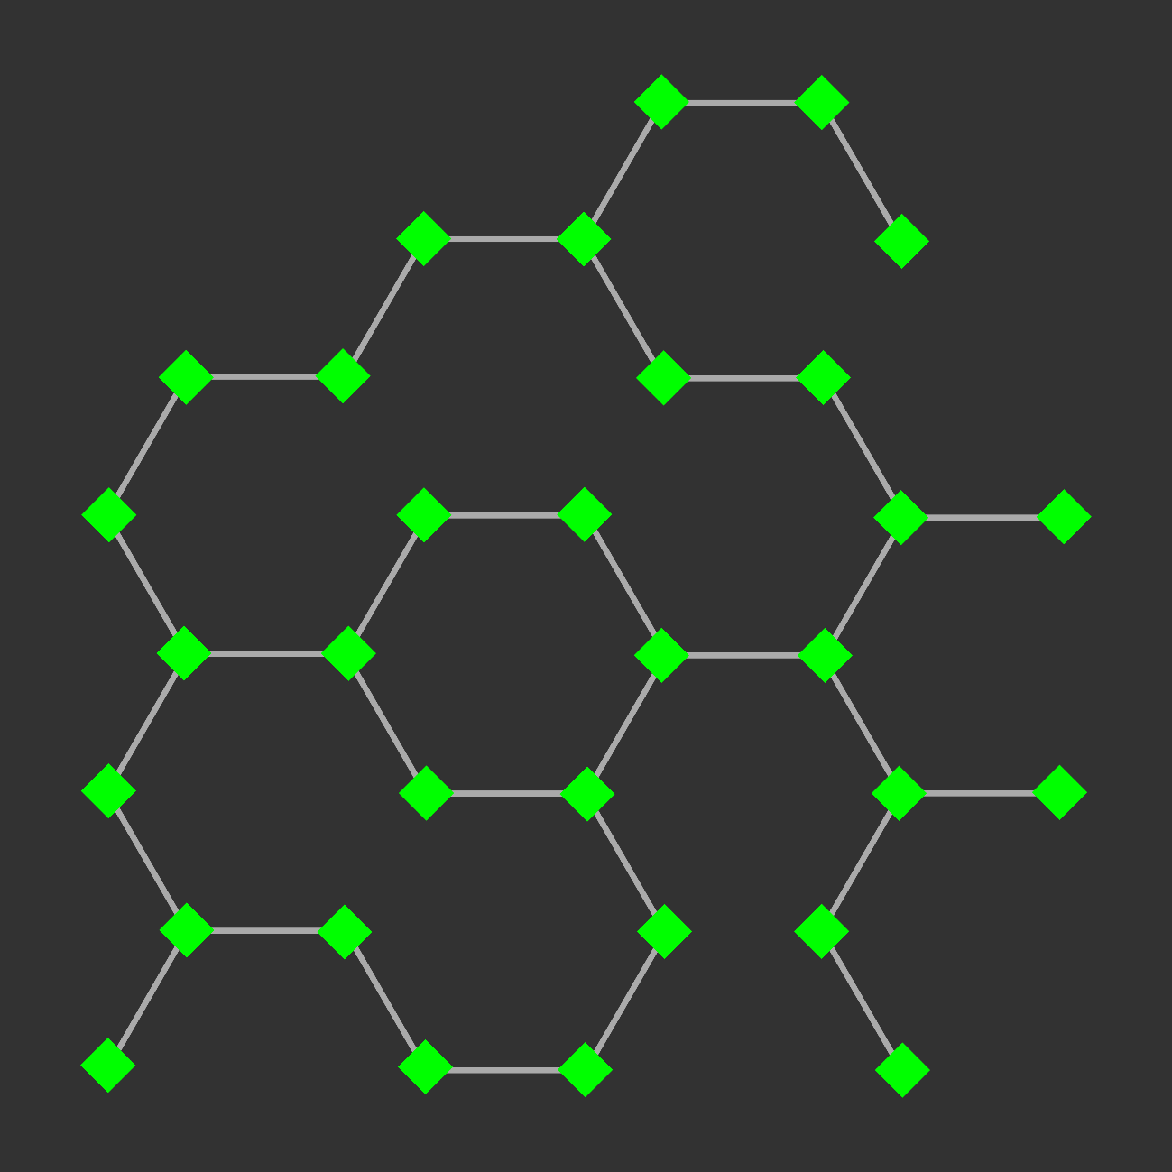
Network Visualization: Exploration And Analysis

Slide 29
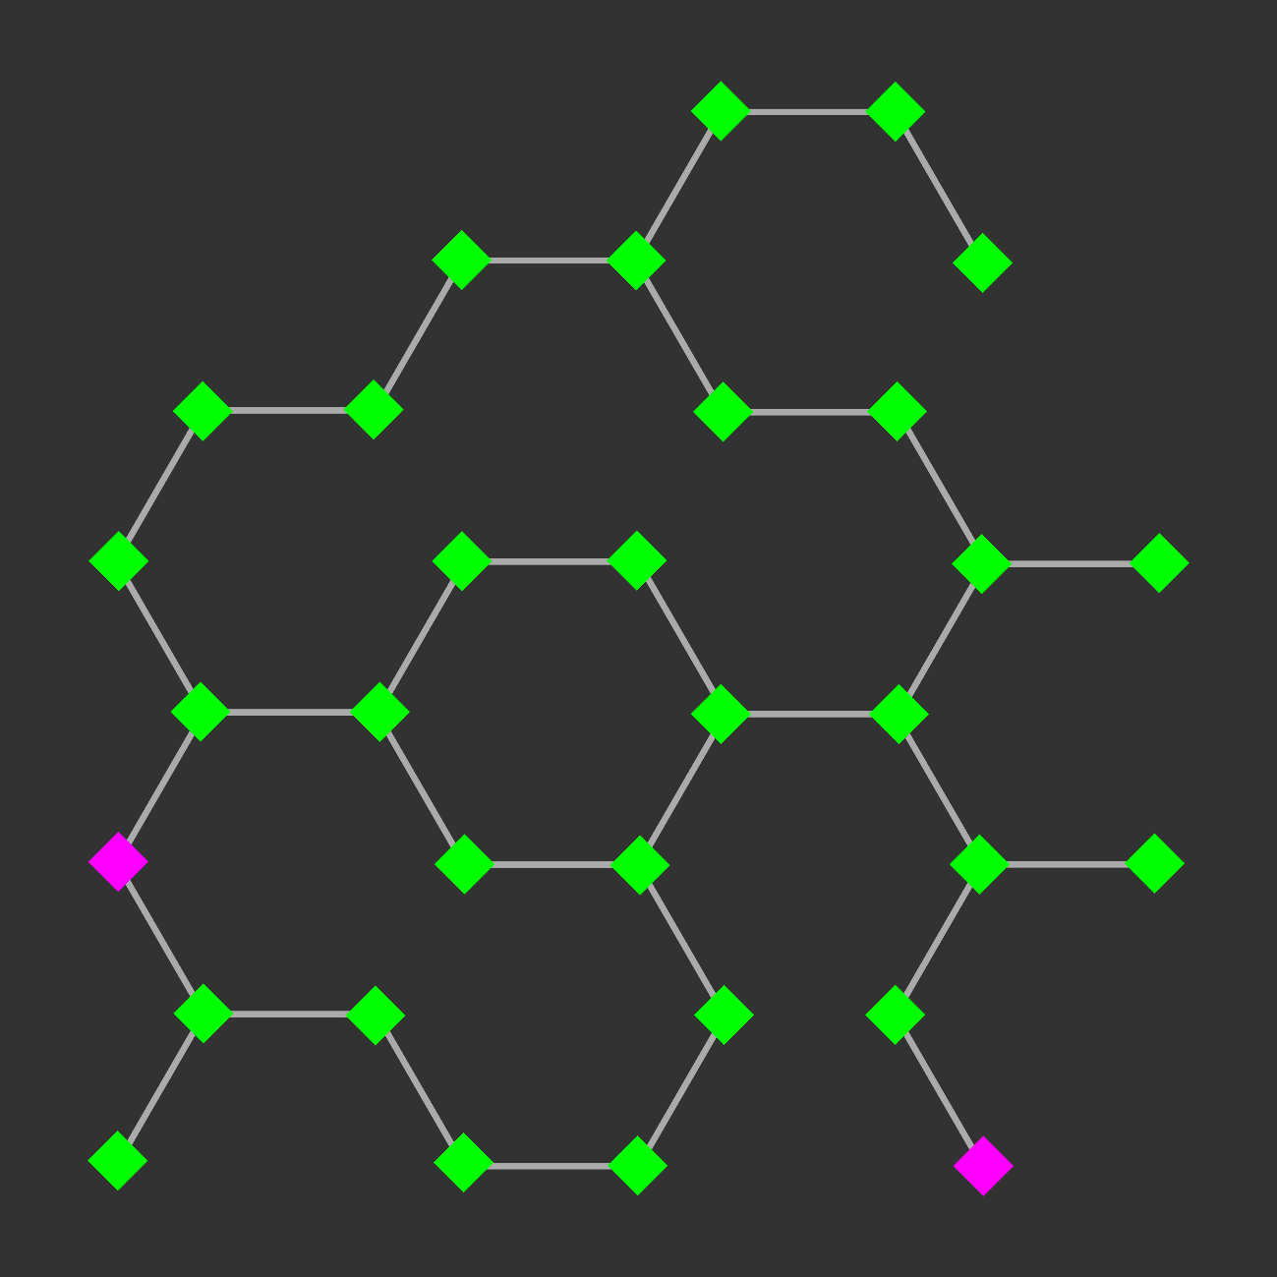
Network Visualization: Exploration And Analysis
Find paths between nodes:
- Shortest path

Slide 30
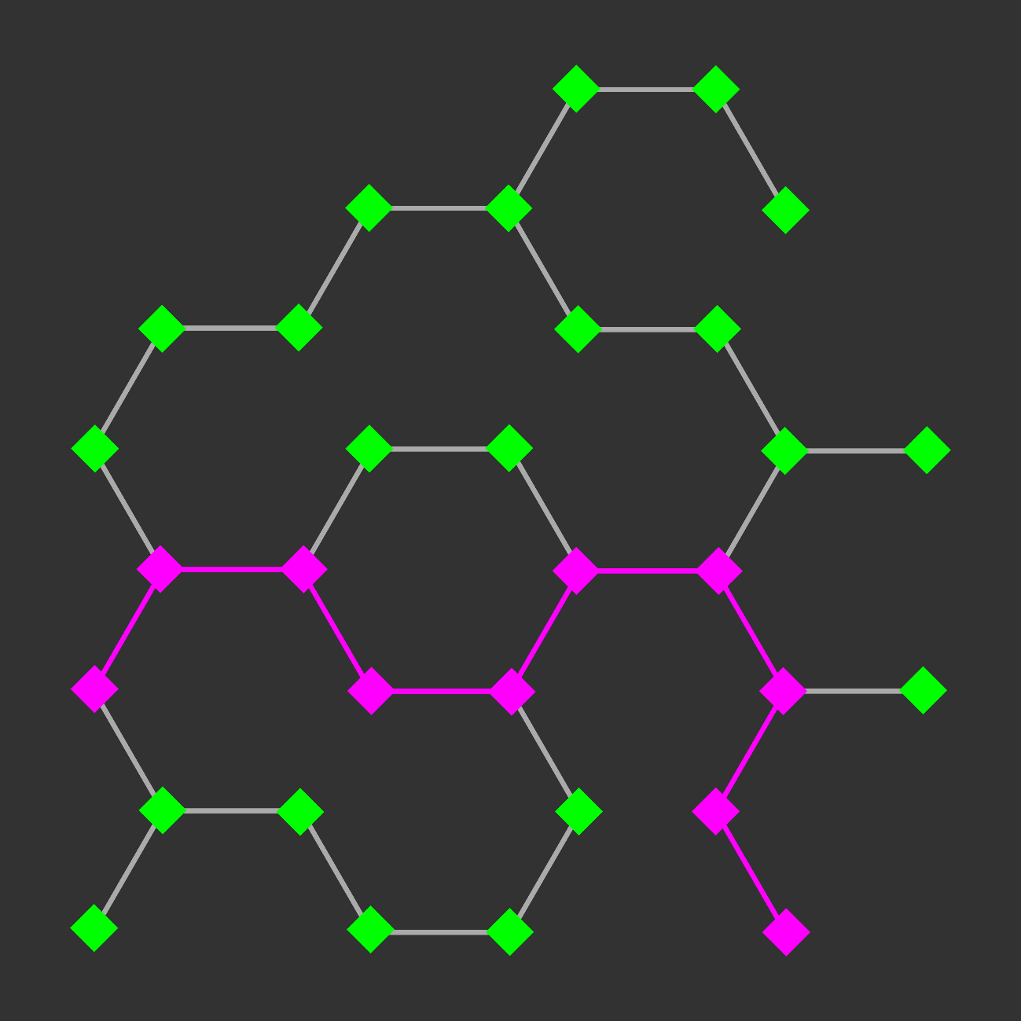
Network Visualization: Exploration And Analysis
Find paths between nodes:
- Shortest path

Slide 31
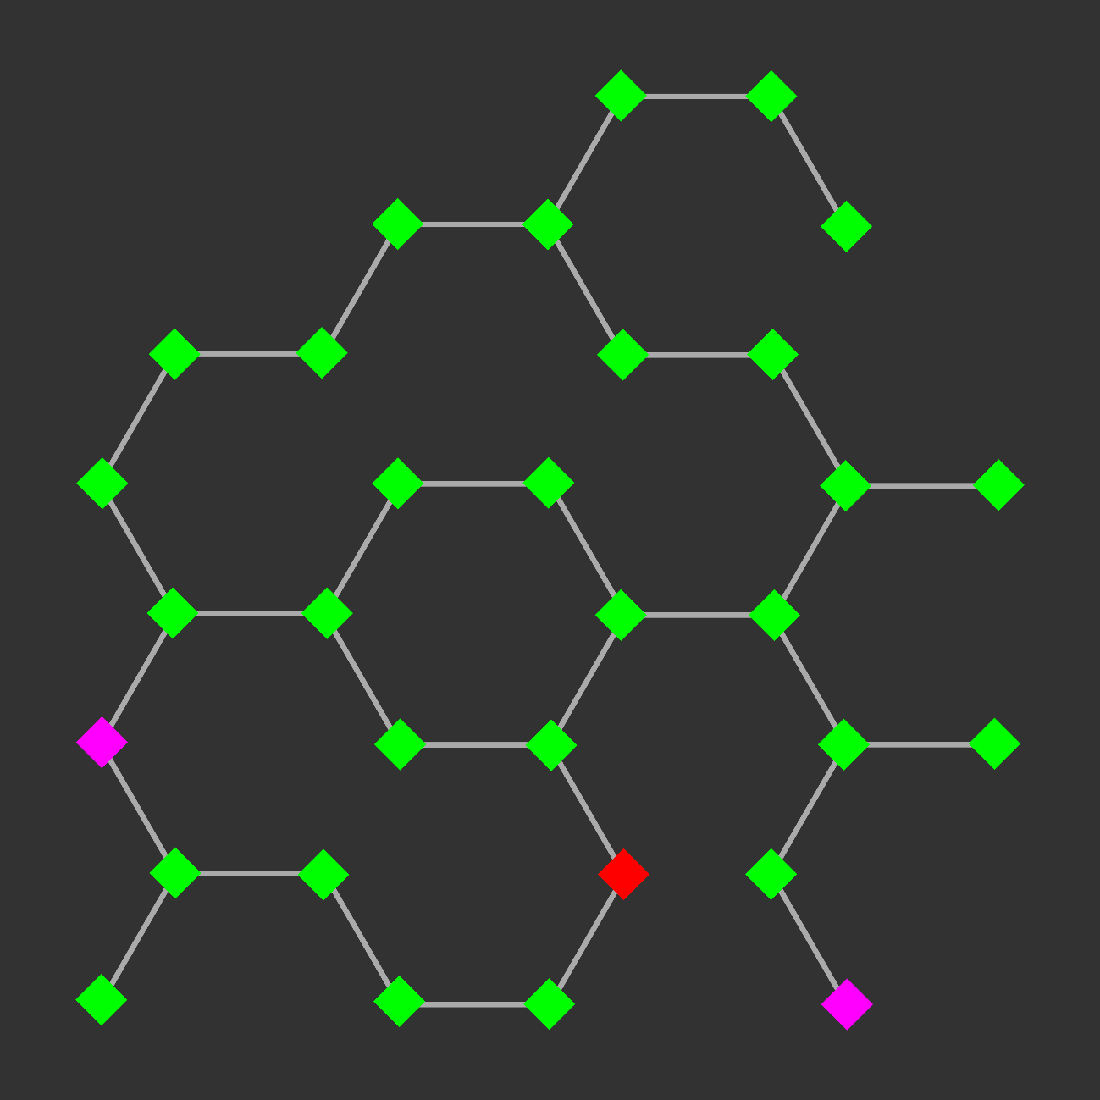
Network Visualization: Exploration And Analysis
Find paths between nodes:
- Shortest path
- Shortest path including or excluding another node or classification
- Path with greatest flux rate

Slide 32
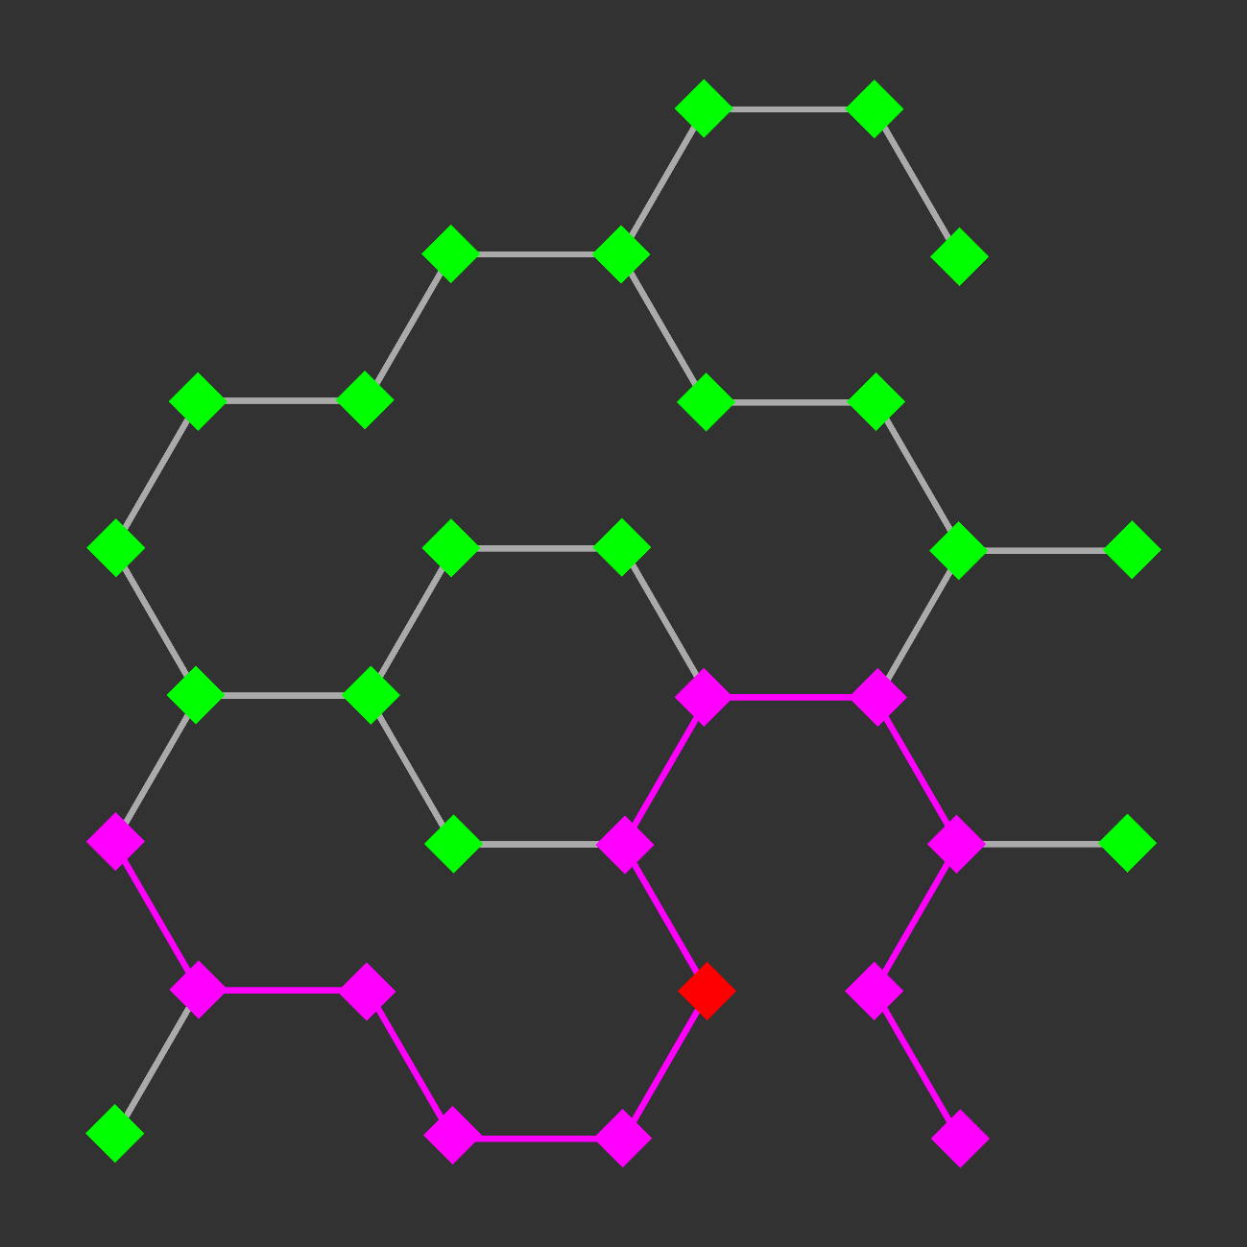
Network Visualization: Exploration And Analysis
Find paths between nodes:
- Shortest path
- Shortest path including or excluding another node or classification
- Path with greatest flux rate

Slide 33
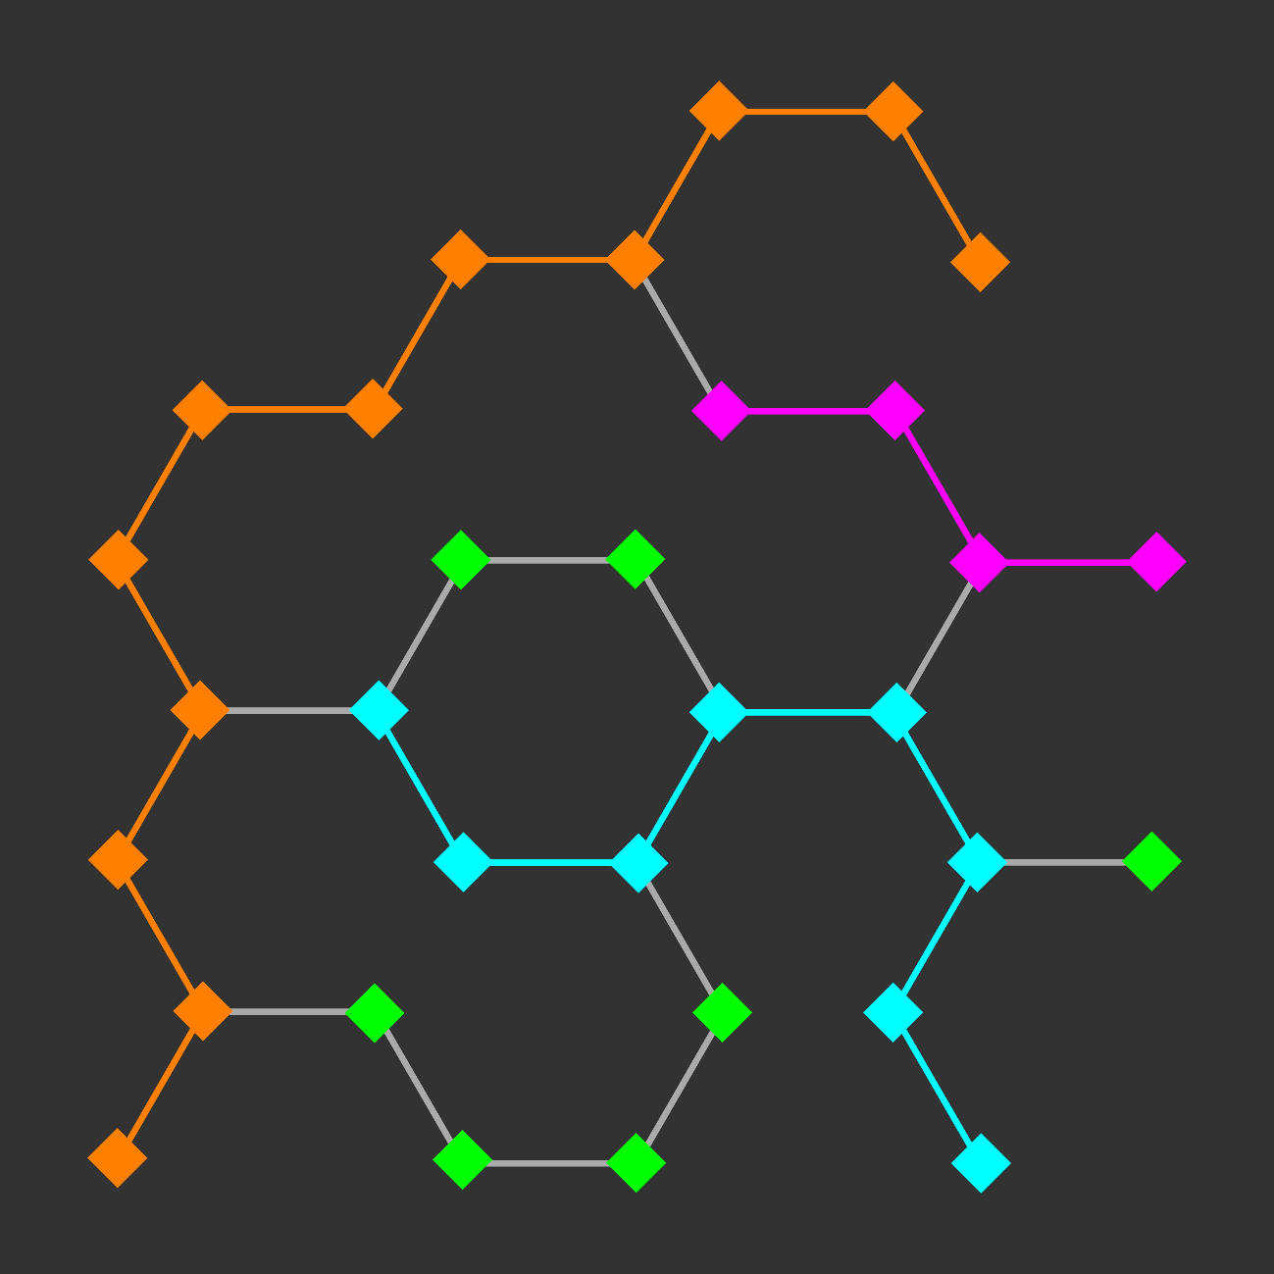
Network Visualization: Exploration And Analysis
Find paths between nodes:
- Shortest path
- Shortest path including or excluding another node or classification
- Path with greatest flux rate
- Specific metabolic pathway

Slide 34
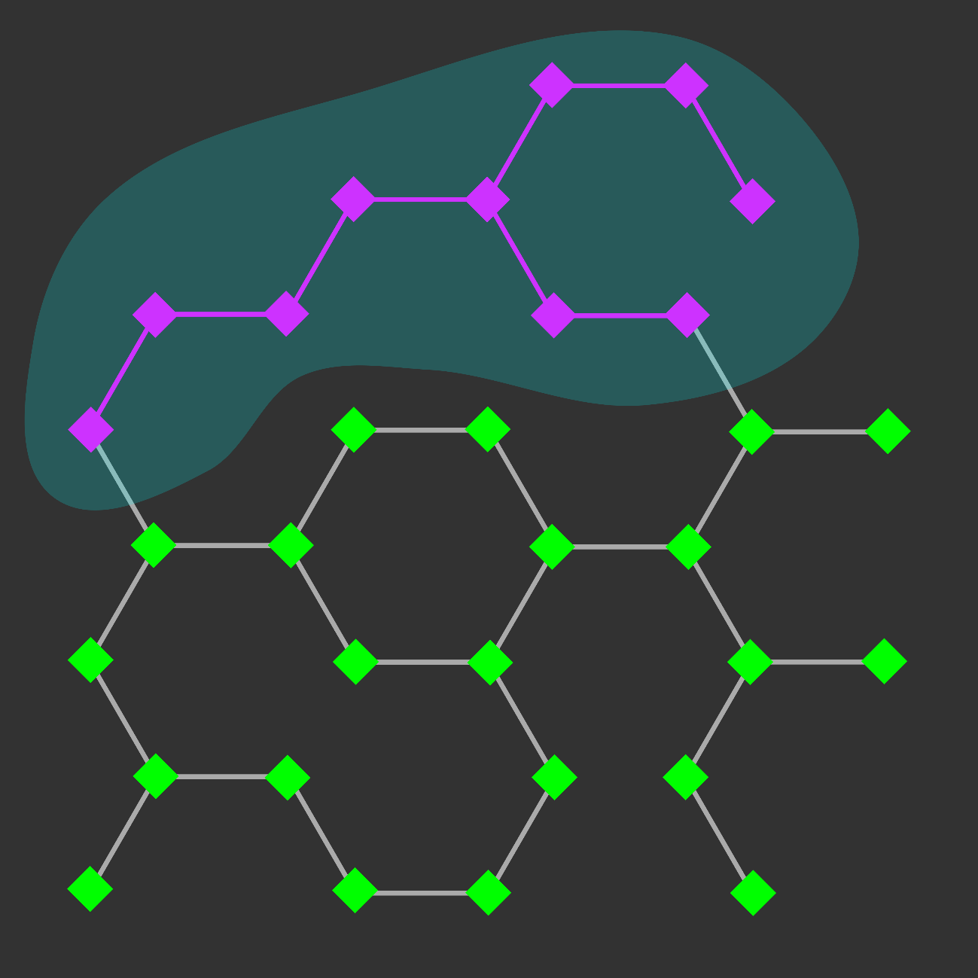
Network Visualization: Exploration And Analysis
Find paths between nodes:
- Shortest path
- Shortest path including or excluding another node or classification
- Path with greatest flux rate
- Specific metabolic pathway
- Specific cellular compartment

Slide 35
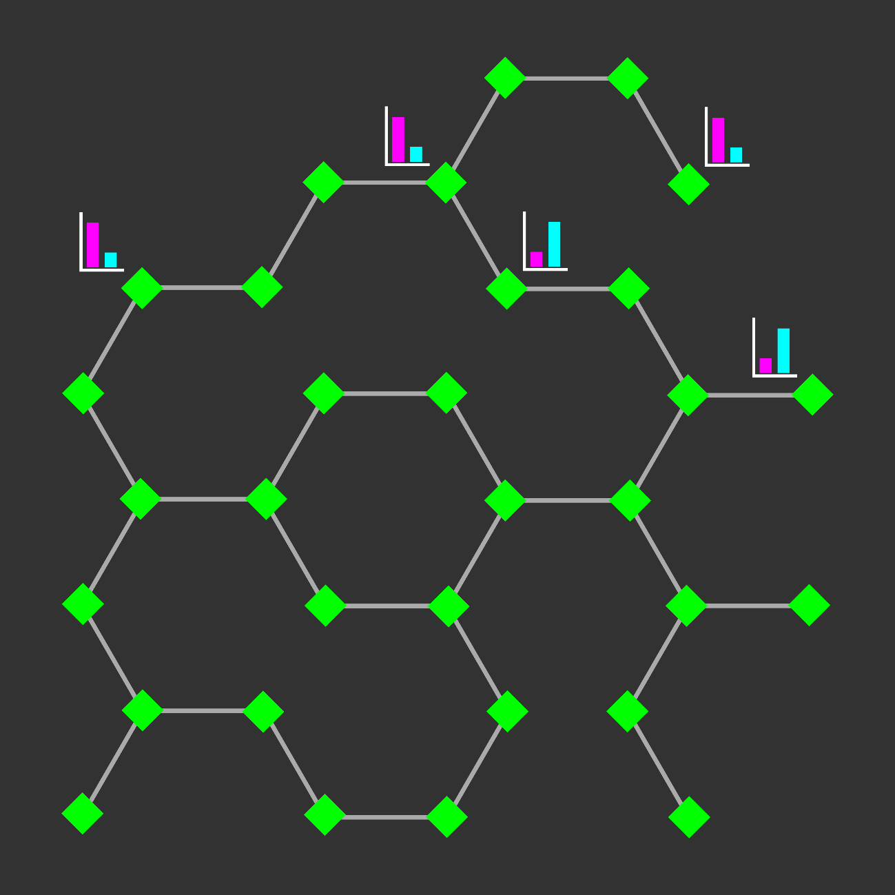
Network Visualization: Exploration And Analysis
Find paths between nodes:
- Shortest path
- Shortest path including or excluding another node or classification
- Path with greatest flux rate
- Specific metabolic pathway
- Specific cellular compartment
- Paths between all nodes with significant change in experimental data

Slide 36
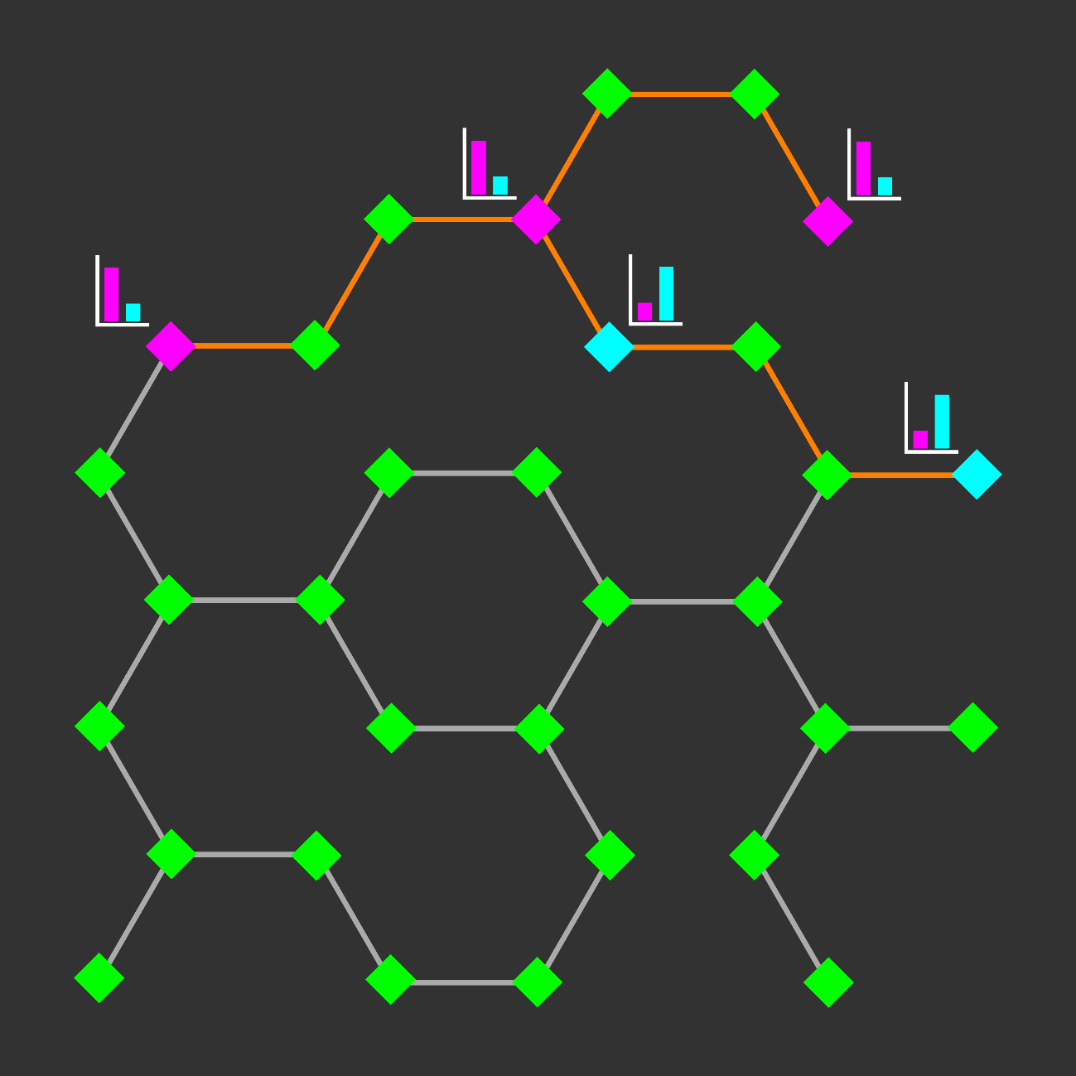
Network Visualization: Exploration And Analysis
Find paths between nodes:
- Shortest path
- Shortest path including or excluding another node or classification
- Path with greatest flux rate
- Specific metabolic pathway
- Specific cellular compartment
- Paths between all nodes with significant change in experimental data

Slide 37

Network Visualization: Exploration And Analysis
Find paths between nodes:
- Shortest path
- Shortest path including or excluding another node or classification
- Path with greatest flux rate
- Specific metabolic pathway
- Specific cellular compartment
- Paths between all nodes with significant change in experimental data
Recognize trends:
- Find common features of multiple nodes with significant change in experimental data

Slide 38
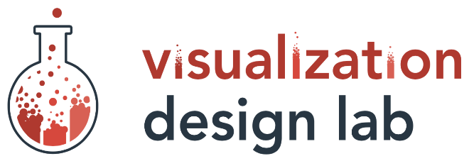



Acknowledgements
Teams:
Rutter Lab
(We need a logo!)
Visual Design Lab
Support:
National Institutes of Health
Training Program
Computational Metabolism
1T32DK11096601
Mentors:
Alexander Lex
Assistant Professor
Jared P Rutter
Professor
Committee:
Brian E Chapman
James E Cox
Adam L Hughes
Janet Iwasa

Slide 40





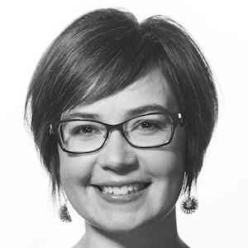
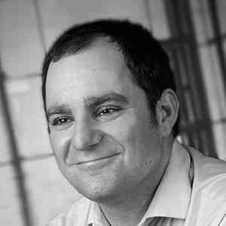
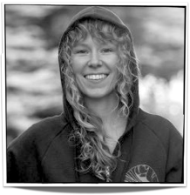





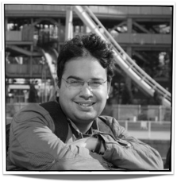
Ethan Kerzner
Alex Bigelow
Sean McKenna
Sam Quinan
Miriah Meyer
Alexander Lex
Nina McCurdy
Jimmy Moore
Asmaa Aljuhani
Carolina Nobre
http://vdl.sci.utah.edu/
Cameron Waller
Magdalena Schwarzl
Sunny Hardasani
Alexander Lex, August 2016

